Slide 1
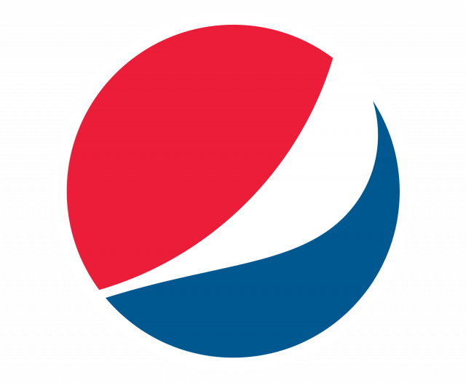
Pepsi Boost : Creative Brief

Slide 2
Flight Dates
Flight Dates:
Flight Dates: extend end date to 12/31/2021

Slide 3
Product(s) + Campaign Name
Campaign Name: Super Bowl Campaign (W/payments & contracting)
Campaign Priority at Pepsi: P1
Product: On 7/7, Pepsi launched a new bottle form: up to 355 ml.

Slide 4
Social Platforms + Post Tyle
Social Platforms:
Instagram and/or TikTok (paid media cannot run on Instgram - must all run on YT + TikTok)
YouTube (1x Talent Only)
Post Type: Mix of Image/Video/Dedicated YT Video
Content Strategy for TikTok + IG:
Talent to post content on TikTok and share to IG via stories
IG stories to swipe up to: https://www.pepsi.com/#!products/1893-original-cola

Slide 5
Creative Overview
Concept: “Life is a moment. Play it."
The football campaign was developed as part of the Pepsi Moments communication platform, which reveals various life situations in which the participants make decisions “here and now”.
Pepsi invites fans to look at life as a series of football moments: all you have to do is live, play, score and win. The main idea of ​​the campaign is reflected in the slogan - “Life is a moment. Play it."
The main element of the campaign was a video, which tells the stories of people who are passionate about football and transferred their passion to real life. These stories are not only about football, they are about fun, celebration, team spirit, support and friendship - values ​​that unite sport and everyday life. In the video, you can see ordinary guys demonstrating football tricks (dribbling) with a Pepsi can in the underpass, and real football fans who gathered to support their team.
To further experience the most anticipated event of the football season, the Pepsi brand has prepared a joint project Pepsi TV, which will not only allow you to immerse yourself in the game, but also win tickets to the UEFA Champions League Final.

Slide 6
VISUAL EXAMPLES

Slide 7
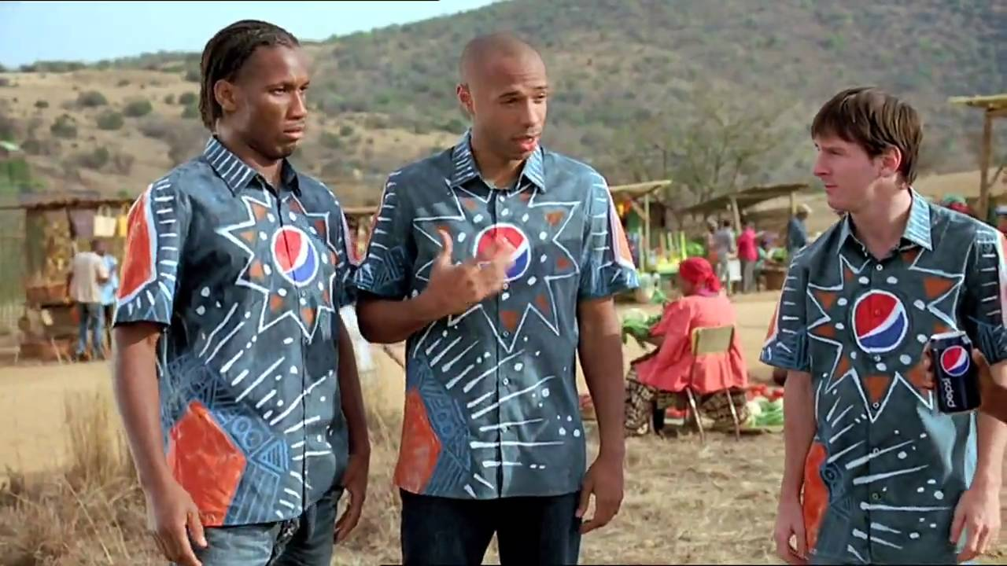

Slide 8
Campaign Copy
NO For the Content and disclaimer:
Considering:
Plan savings: Up to $25 off/month + Partners breakdown below:
Play More: Disney Bundle - $12.99/month & Apple Music (6 months) - $9.99/month
Get More: Disney Bundle - $12.99/month & Apple Music - $9.99/month
Todoist: $3/month on any plan (6 months for free)
Proposed messaging:
As a student you can save UP TO $25/month on your plan and can get access to partners like Disney+,Hulu, ESPN+, Apple Music and Todoist.
If the influencers are going to be leveraging the bundle extra savings they will need to provide a breakdown of where that math is coming from:
Disney+ Bundle - $12.99/month
Apple Music: $9.99/month
Todoist: $3
Partners total savings: Additional $25.98
Legal considerations:
Encourage followers to learn more on Verizon's landing page for Students (ww.vzw.com/students)
If utilizing all partners' savings call out that this is possible on the Get More Unlimited Plan. This could also be a great opportunity to let students know that they can choose the plan that works best for them according to the partners that they want to have access to.
When leveraging the savings and saying what they can do with the savings: Ie. You could get 10 more lattes from your favorite coffee shop (Stay away of mentioning other brands - ie. 10 more Starbucks lattes)
Required Brand Tags: @Verizon
FTC Requirements: #VerizonPartner

Slide 9
Brand Guidelines
NO
Discount Eligibility:
Current U.S secondary education, online and vocational students
Limited to max of 2 lines (discount drops to $0 for 3rd line)
4 year maximum discount Verification/student validation vendor: UNiDAYS
Ability to highlight any device offer that would be attractive to the Segment in Q4 (ie. Samsung, Iphone or any switcher promotion).

Slide 10
Product Placement

Slide 11
Talent Approvals / Talent Requirements
Talent List: https://captiv8.io/public/talents/list/NdBHYTdhR5n5821m
Top Selects:
Tier 1: Cody Ko
Tier 2: Brodie Smith
Tier 3: Trey Kennedy
Backup Selects:
T1. Oscar Miranda
T2. Arielle Vandenberg
T3. Rob Riggle
Talent Requirements:
Active lifestyle, sport
Located in US

Slide 12
Usage / Exclusivity
Usage Rights:
Standard terms cover the advertiser right to re-post/share the content on their own social media accounts + O&O [in social widget format], during the term. Content shared on social can remain up in perpetuity and content shared on O&O can remain up, during the term.
Extended usage allows for the advertiser to amplify content via paid media on the brands social handle up to 10M impressions, per piece of content, during the term.
(Term: 3 Months)
Exclusivity & Term:
Captiv8’s pricing accounts for an exclusivity period and term of 30 days, anything beyond this may incur additional fees and can be negotiated on an influencer per influencer basis.
Competitive Class: Non-alcohol drinks.

Slide 13
Goal / KPI
Campaign Success Metrics:
Engagement
Audience conversation
Brand sentiment
CTR

Slide 14
Next Steps
Timeline
8/6: Pepsi to provide list of approved talent
8/11: Captiv8 to kick off talent outreach
8/13: Captiv8 to provide recommended talent/deliverables
8/13: Pepsi to confirm talent/deliverables
8/16: Captiv8 to issue formal offers
8/18: Captiv8 to confirm talent
8/18: Captiv8 to provide talent's creative concept
8/19: Pepsi to provide concept feedback
8/20: Captiv8 to provide updated creative concepts
8/20: Pepsi to approve concepts
8/23: Talent in Production
8/24: Captiv8 to provide content and captions
8/30: Captiv8 to provide final content
11/30: Captiv8 to provide final content
8/1: Pepsi to approve Content
8/2: Launch

